Slide 1
5
Introduction to Valuation: The Time Value of Money

Slide 2
Chapter 5 – Index of Sample Problems
Slide # 02 - 03 Simple interest versus compound interest
Slide # 04 - 06 Future value
Slide # 07 - 09 Present value
Slide # 10 - 12 Interest rate for a single period
Slide # 13 - 15 Interest rate for multiple periods
Slide # 16 - 18 Number of time periods
Slide # 19 Present value and rate changes
Slide # 20 Future value and rate changes
Slide # 21 Present value and time changes
Slide # 22 Future value and time changes

Slide 3
2: Simple versus compound interest
First United Bank pays 4% simple interest on their savings accounts. Second Federal Bank pays 4% interest compounded annually on their savings accounts.
If you invest $1,000 in each bank, how much will you have in your accounts after twenty years?
Why are the balances different?

Slide 4
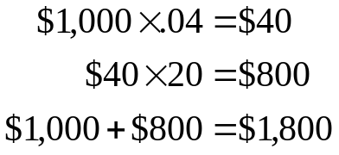
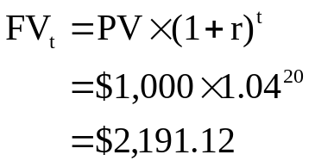

3: Simple versus compound interest
First United Bank
Second Federal Bank
Difference

Slide 5
4: Future value
You invest $3,000 in the stock market today.
How much will your account be worth forty years from now if you earn a 9% rate of return?

Slide 6
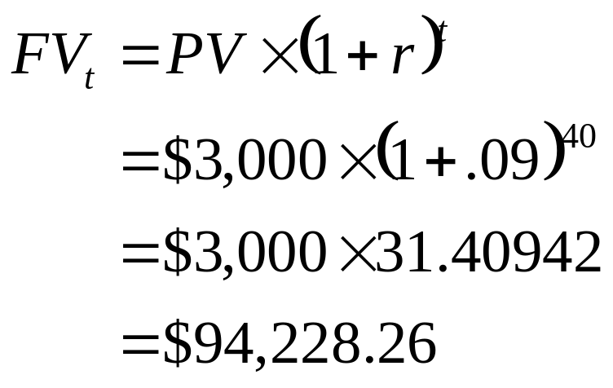
5: Future value

Slide 7
6: Future value
Enter 40 9 ±3,000
N I/Y PV PMT FV
Solve for 94,228.26

Slide 8
7: Present value
You want to have $7,500 three years from now to buy a car. You can earn 6% on your savings.
How much money must you deposit today to have the $7,500 in three years?

Slide 9
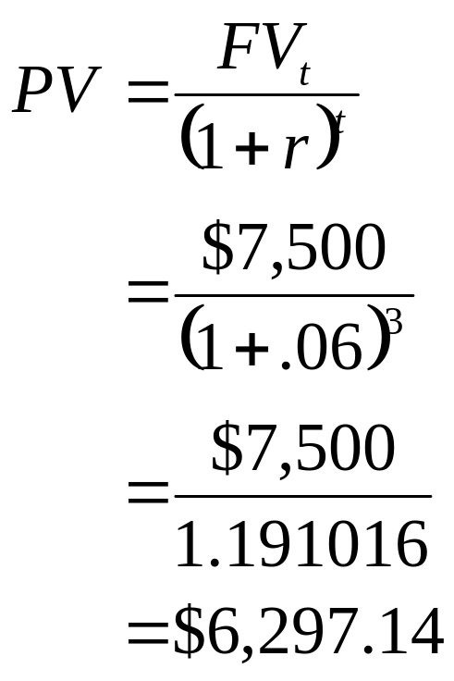
8: Present value

Slide 10
9: Present value
Enter 3 6 7,500
N I/Y PV PMT FV
Solve for -6,297.14

Slide 11
10: Interest rate for a single period
Last year your investments were worth $369,289. Today they are worth $401,382. No deposits or withdrawals were made during the year.
What rate of return did you earn on your investments this year?

Slide 12
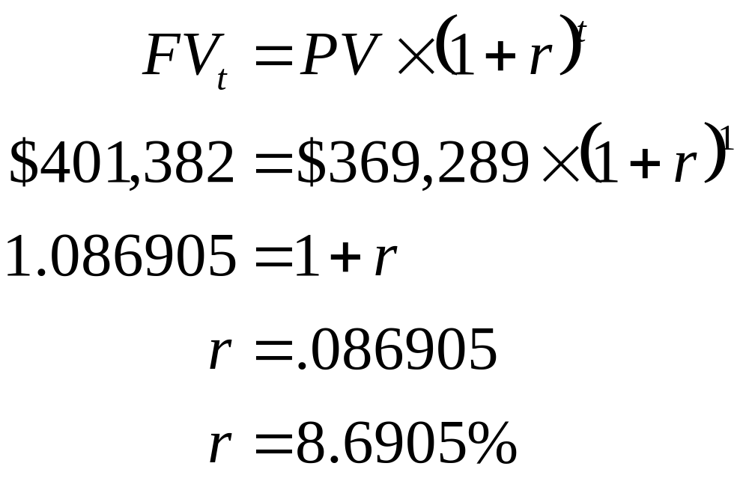
11: Interest rate for a single period

Slide 13
12: Interest rate for a single period
Enter 1 ±369,289 401,382
N I/Y PV PMT FV
Solve for 8.6905

Slide 14
13: Interest rate for multiple periods
The City Museum owns a rare painting currently valued at $1.2 million. The museum paid $240,000 to purchase the painting twelve years ago.
What is the rate of appreciation on this painting?

Slide 15
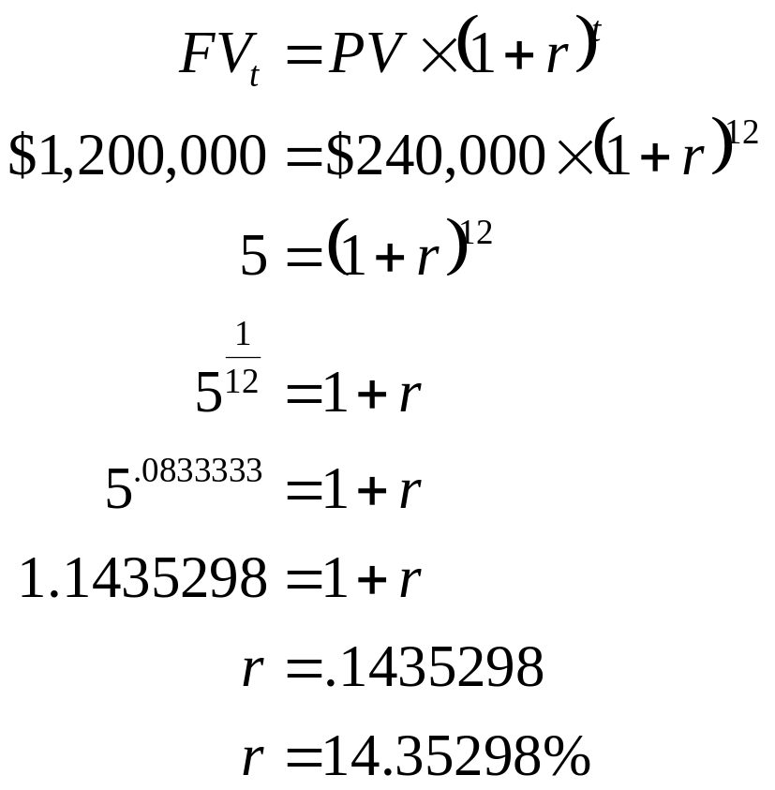
14: Interest rate for multiple periods

Slide 16
15: Interest rate for multiple periods
Enter 12 ±240,000 1,200,000
N I/Y PV PMT FV
Solve for 14.35298

Slide 17
16: Number of time periods
Tom originally started to work for Jackson Enterprises at an annual salary of $36,500. Today, Tom earns $68,200. Tom calculated that his average annual pay raise has been 3.4%.
How long has Tom worked for Jackson Enterprises?

Slide 18
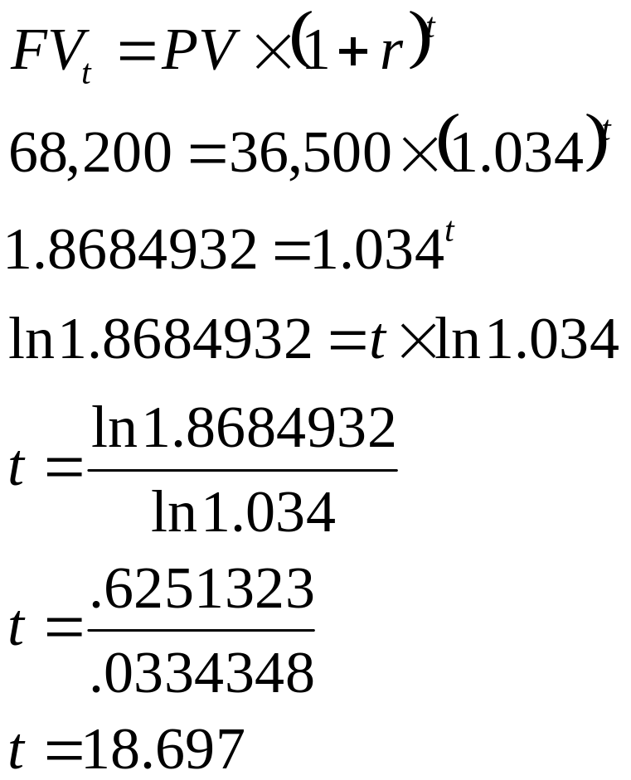
17: Number of time periods

Slide 19
18: Number of time periods
Enter 3.4 ±36,500 68,200
N I/Y PV PMT FV
Solve for 18.697

Slide 20
19: Present value and rate changes
Enter 1 6 100
N I/Y PV PMT FV
Solve for -94.34
Enter 1 7 100
N I/Y PV PMT FV
Solve for -93.46

Slide 21
20: Future value and rate changes
Enter 1 6 ±100
N I/Y PV PMT FV
Solve for 106
Enter 1 ±100
N I/Y PV PMT FV
Solve for 107

Slide 22
21: Present value and time changes
Enter 1 5 100
N I/Y PV PMT FV
Solve for -95.24
Enter 2 5 100
N I/Y PV PMT FV
Solve for -90.70

Slide 23
22: Future value and time changes
Enter 1 5 ±100
N I/Y PV PMT FV
Solve for 105
Enter 2 5 ±100
N I/Y PV PMT FV
Solve for 110.25

Slide 24
5
End of Chapter 5

